Slide 1


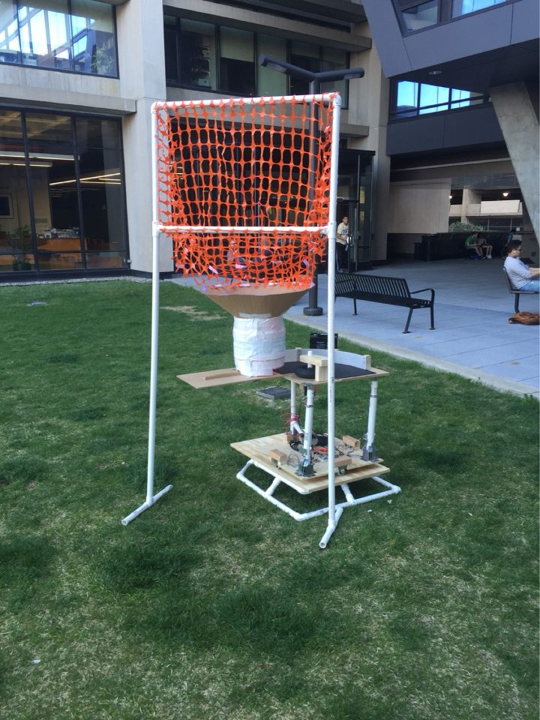
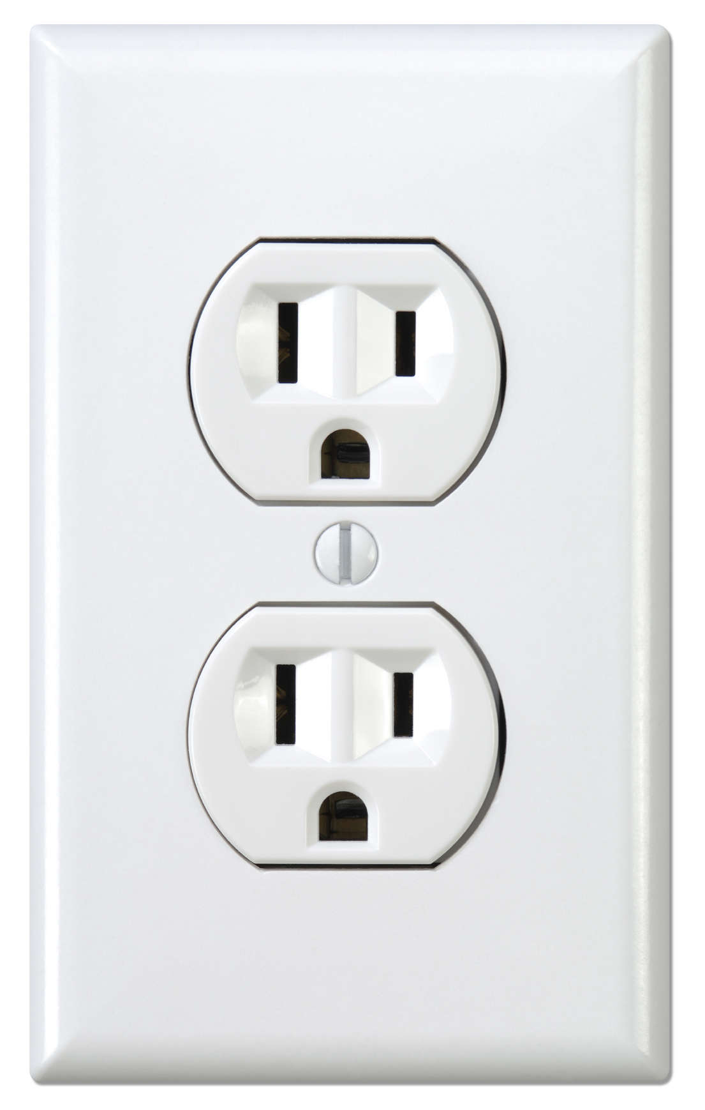
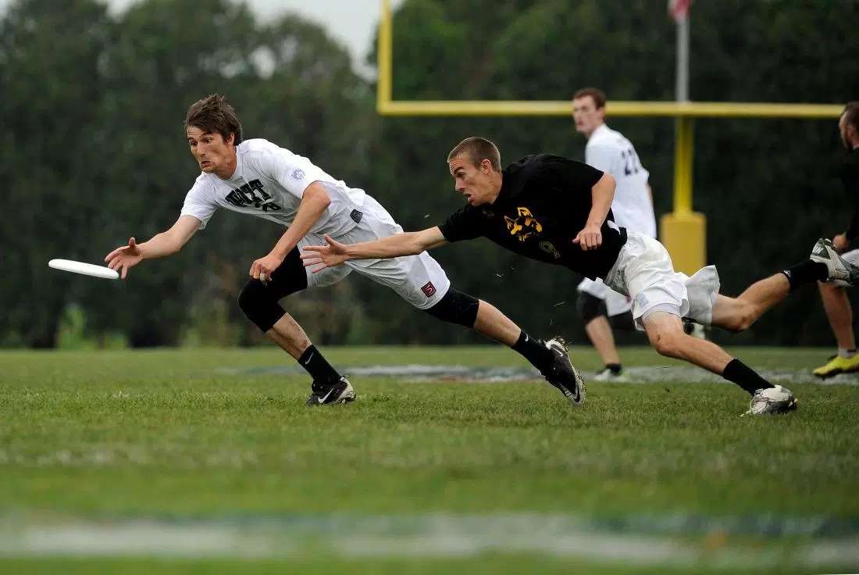
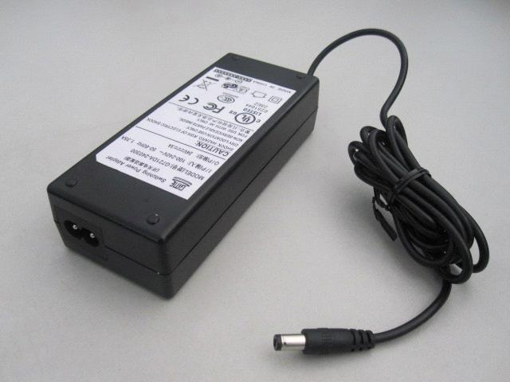
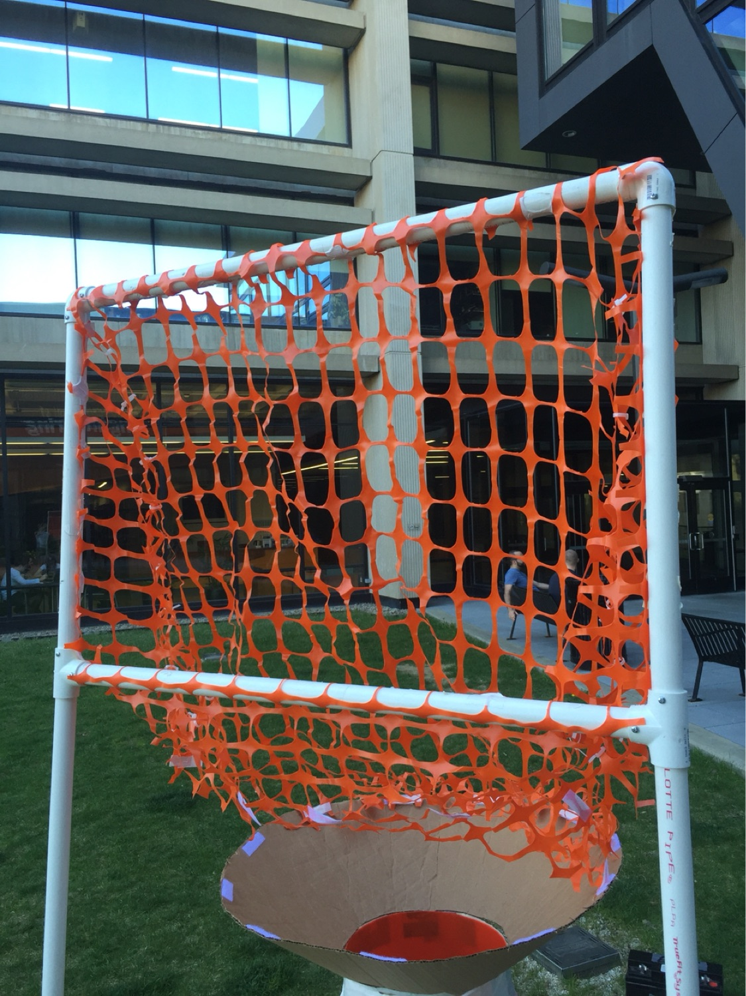
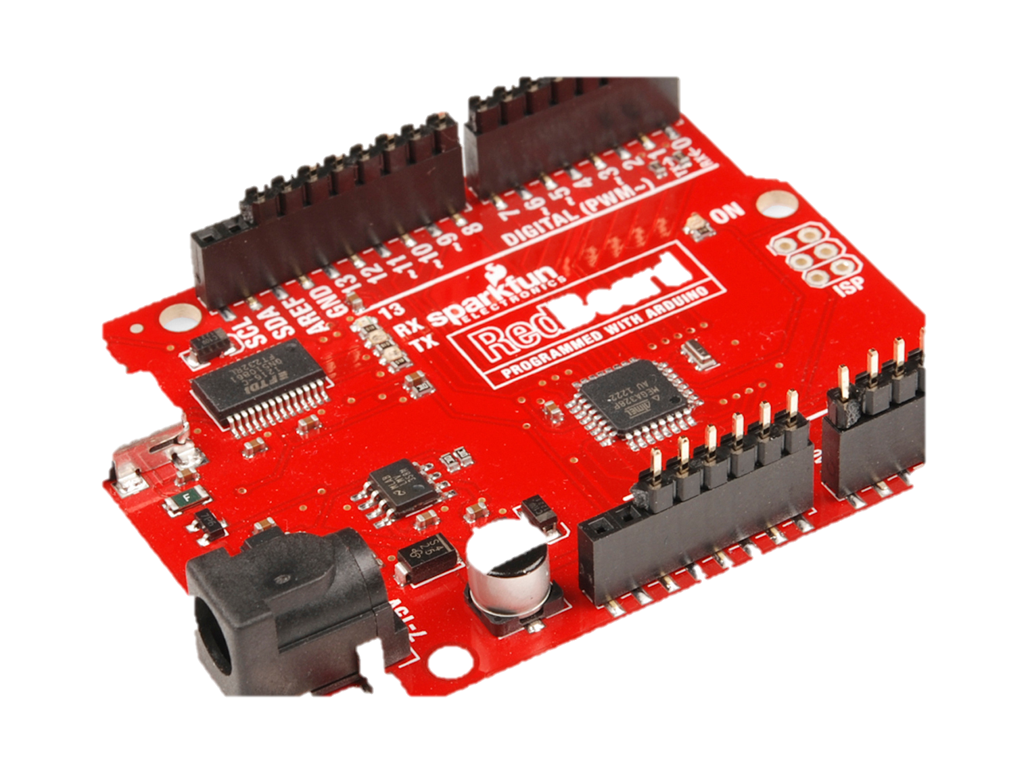
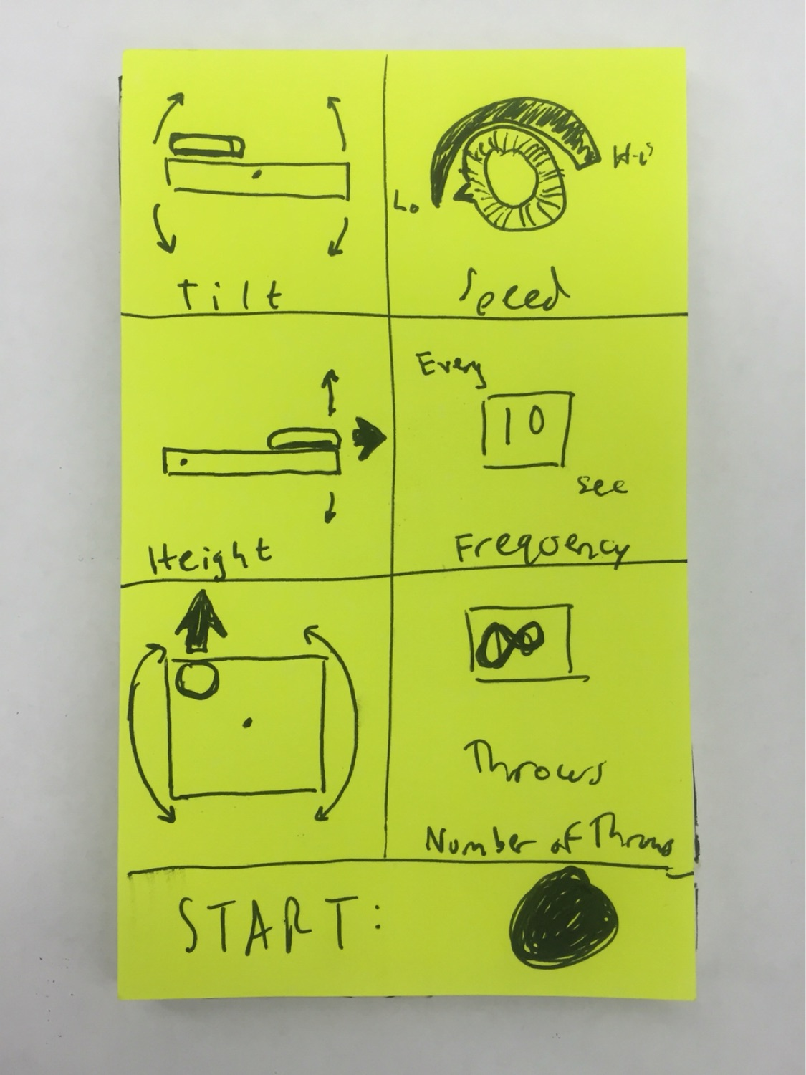

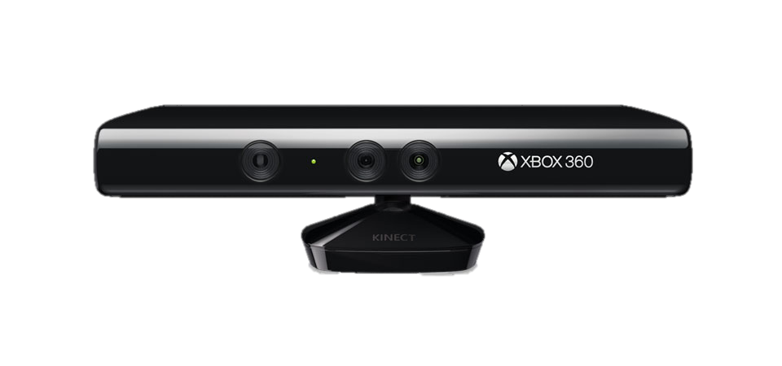
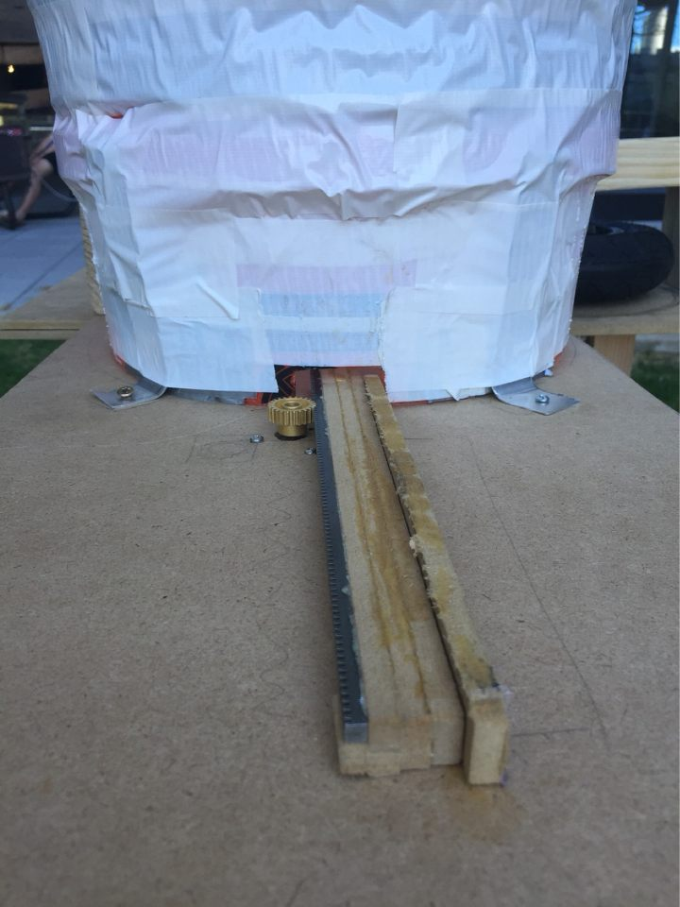
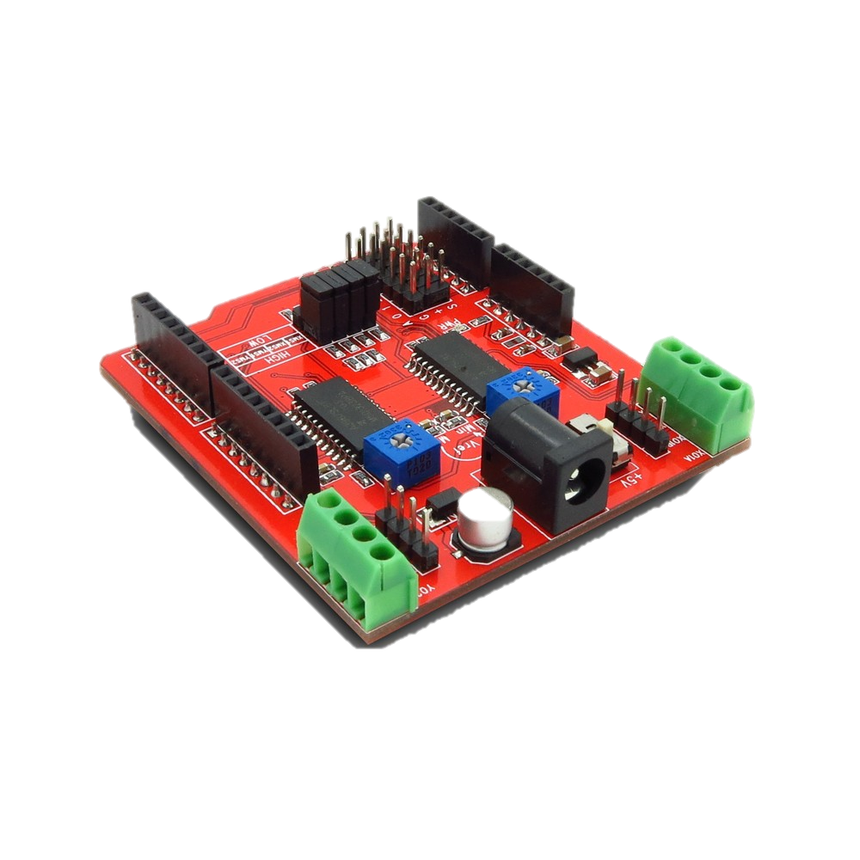
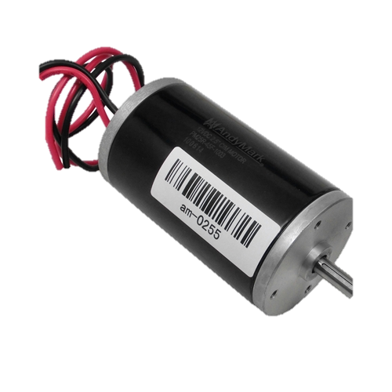
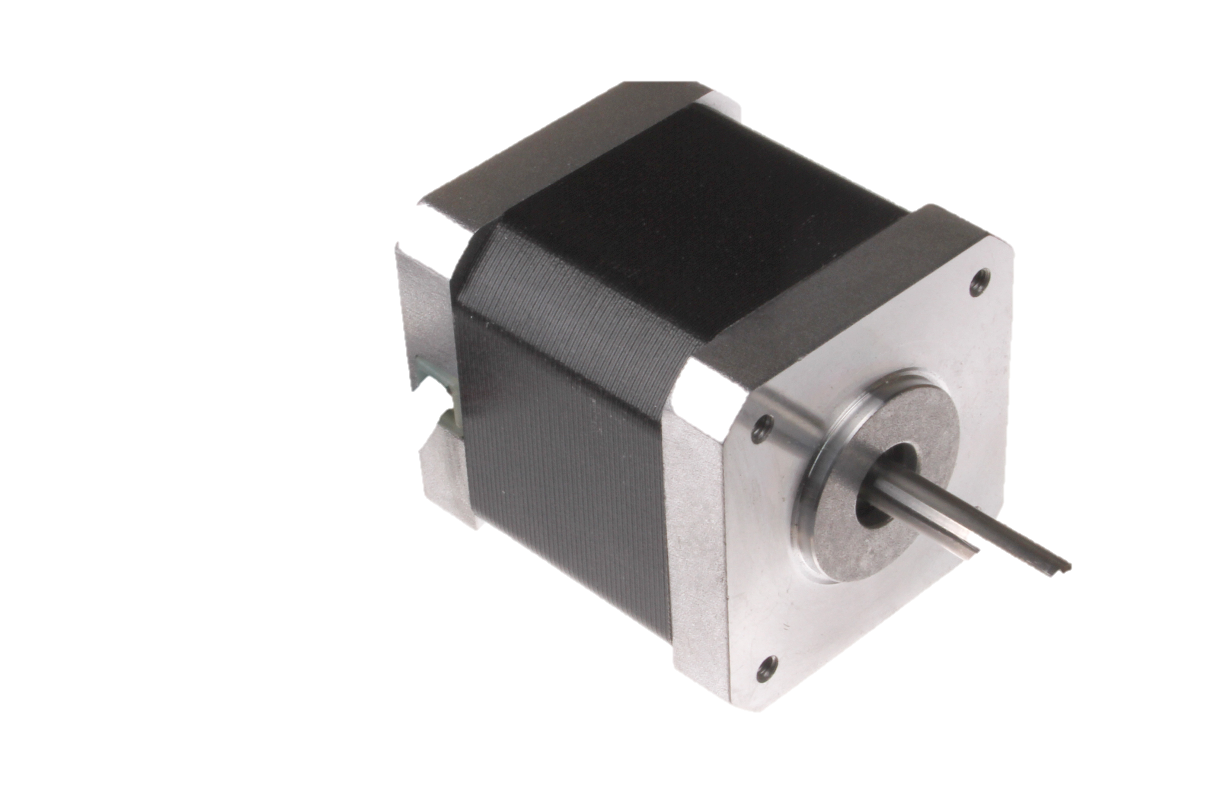
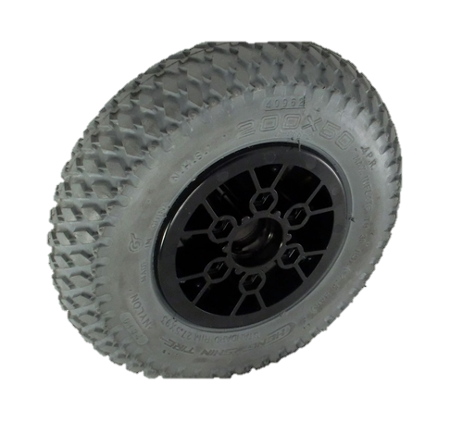
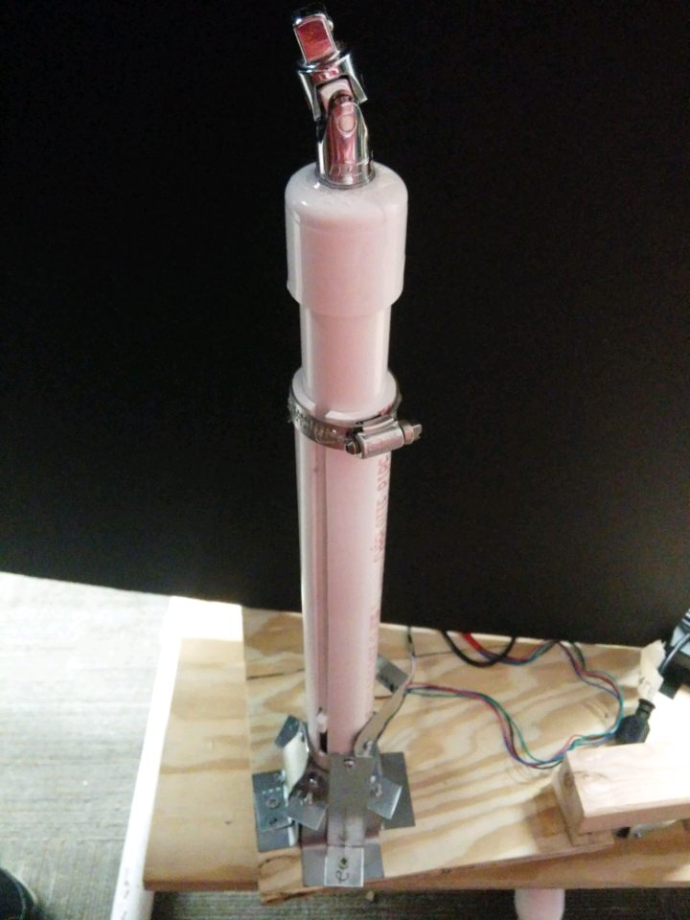
Frisbot
An All Inclusive Ultimate Frisbee Training Device
Michael Ing(mci10@pitt.edu), Devon Callanan, Seth Appel, Ben Linsey, Max Naar, Liam Gillen-Hughes, Justin Keller, Stanley Umeweni
Problem Statement
Ultimate Frisbee is a relatively new sport at only 48 years old, and does not offer the same training opportunities that other sports do. We want to make solo ultimate training a reality.
Design
Future Directions
To be fully functional, the shooter must fire up to 30 yards. It currently shoots about 15 feet, so we would look to increase this distance using higher quality materials.
The base rotates manually, so we would replace the stepper with a stronger motor to automate this function.
Add a remote control user interface to allow player to adjust settings at a distance
Use advanced motion capture technology such as Xbox Kinect® to aim at targets
CATCHER &
SHOOTER
Outlet
Catcher
(Net)
BASE
Human Centered Design
Our users include all competitive Ultimate Frisbee players, which is estimated to be 7 million men and women around the world.
“It’d be useful because there are many times when players want to throw but their teammates aren’t available, so having [Frisbot] at their disposal would be super beneficial.”
- Katie Cleveland, member of the Pitt Women’s Ultimate Frisbee Team
AC/DC Converter
Final Product
12V Battery
Arduino
Loader
Design Goals
Shoot Frisbee at a distance of 20-30 yards x
Successfully catch and reload Frisbees✓
Allow user control of:
Release angle of the Frisbee (pitch and yaw) up to 45⁰ ✓
Automated rotation of the base (180⁰) ✗
Frequency and number of throws ✓
Graphical user interface with remote start button ✓/ ✗
CIM Motor
Motor Driver x3
Acknowledgements
We would like to thank:
Dr. Joseph Samosky, Bill Mcgahey, and all of the TA’s, especially Nick Petro and Nate Smialek, for their guidance
The University Honors College for their funding
The Pittsburgh Ultimate Frisbee men’s team and women’s team
High Torque Stepper Motor x3
Shooter with 8 - inch wheel
Pistons x2

